Slide 1




17-21 March 2014 Nairobi, Kenya
Emergency Market Mapping Analysis (EMMA)
Pat Foley
Carol Ward

Slide 2
Day 1 plan
Session | Timing
Opening; markets and market systems | 120
Tea | 30
EMMA | 90
Lunch | 60
Activity: Secondary map analysis | 90
Tea | 15
Activity: Secondary household analysis | 90

Slide 3
Session guide
Section | Timing | Comments
Opening, photo, wealth ranking | 20
Introductions | 10
Why analyse markets + activity | 30
Objectives and housekeeping | 30
String game and cards | 30 | Or do this at the beginning of Session 2

Slide 4
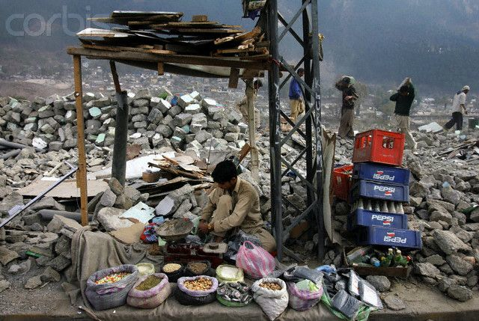

Slide 5
Workshop objectives
By the end of the training course, participants will be able to:
Identify the benefits of market analysis in emergencies
Confidently use criteria for selecting critical market systems and the market mapping tools of EMMA
Analyse data gathered through the use of EMMA tools, and produce suitable options for effective humanitarian response in emergencies based on that data
Apply the EMMA Toolkit in the field, including market mapping and analysis elements of the EMMA process within a real life market context
Explain the value of EMMA to senior decision-makers

Slide 6
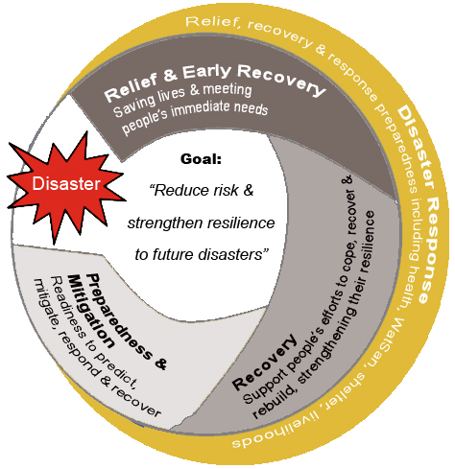
Workshop Focus
Source: IFRC Recovery Programming Guidance 2012

Slide 7



Source material
Notes:
These are the main sources of content, slides, scenario, handouts, activities, etc.
Many other sources are also included, such as HEA data from a range of documents, along with significant injections of original material for linkages, fill, and HES tailoring.

Slide 8
Markets and market systems
Session 1

Slide 9
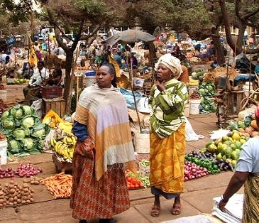
What is a market?

Slide 10
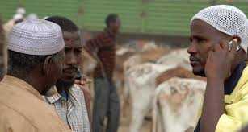
Why analyse markets?

Slide 11

Activity: Market mapping

Slide 12
Emergency Market Mapping and Analysis (EMMA Toolkit)
Session 2

Slide 13
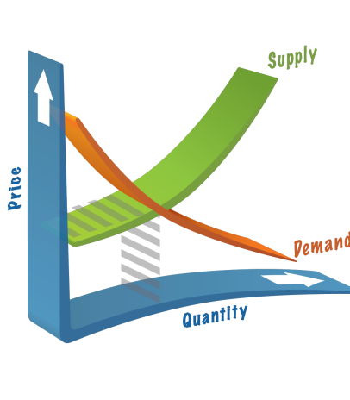
Session content
Market systems
EMMA logic and process
EMMA tools
Notes:
Check and see how many people have market analysis experience

Slide 14
Session guide
Section | Timing | Comments
String game and cards | 30 | If not done in Session 1
Theory lecture | 60

Slide 15
Session outcomes
Describe the role of market analysis in humanitarian programming
Create a basic market system map, describe its function, and illustrate how crises affect markets.
Identify the market impacts of a crisis (number, volume, price).
Explain the purpose and process of EMMA.
Differentiate between direct and indirect market interventions.
Use basic market theory and vocabulary.
Appreciate that market analysis can be less complicated than we might think.
Notes:
Check and see how many people have market analysis experience

Slide 16
Market system: Definition
A market system is a network of producers, suppliers, traders, buyers, and consumers
All are involved in producing, exchanging, and consuming a particular item or service
The system includes various forms of infrastructure, input providers, and services
It operates within the context of the rules and norms that shape this system’s particular business environment

Slide 17
Market systems matter
Ensuring survival:
Providing essential items or services to meet basic needs
Protecting livelihoods:
Providing tools, agricultural inputs and services, or replacing other livelihood assets
Providing jobs and opportunities for wage labour, or linking to buyers for their produce
Notes:
What do markets provide to people in emergencies?

Slide 18
EMMA’s core logic
Notes:
Future forecasting – previous data from disasters, seasonality big element, six month programmes (for e.g.) then revisit analysis for longer term programming
Can start an EMMA as soon as the dust settles (e.g. Haiti 2010 – 2 weeks after (quick one, then full on EMMA), Philippines almost immediately) but need to revisit information

Slide 19
The EMMA process
Flexible, adaptable, built on logical steps
Based on rough and ready, speed-oriented tools for non-economists or statisticians:
‘Good enough’
‘Appropriate imprecision’
Iterative: revise, refine, analyse
Requires selection of critical market systems
Based on market maps: visual and intuitive
Notes:
o Is flexible and adaptable, built around a series of logical steps
o Consider the wider market system, not just the market place and affected
community; markets not only what people depend upon (economic
recovery), but also because in short-term they may be best way to get
humanitarian aid to people (emergency response)
o Based on creation and use of market maps that are visual and intuitive
- market mapping is at the heart of EMMA, and its main tool
o Requires selection of the market systems most critical from an humanitarian perspective; i.e. that one which the agency believes will most effectively help to recover the target group’s lives and livelihoods
o Works both for market systems that supply goods and services, and for those that are a source of income to emergency-affected populations

Slide 20
EMMA as an analysis tool
Main components:
Selecting critical market systems
Baseline and emergency mapping
Market environment
Market chain
Key infrastructure, services and inputs
One map per market system
Gap analysis
Response options and recommendations
Notes:
There are other tools (MAFIRA), but EMMA is simpler:
(baseline and emergency maps)
Through ‘household profiles’ and seasonal calendars (before & after). Similar to Assessment session 3
We will have a go at using this tool and interpreting its information
Similar to response options and cash sessions

Slide 21
EMMA’s core logic: Response options
Support affected households with:
Direct assistance through cash or in-kind transfers (or both) | Indirect actions to strengthen market systems (and households)

Slide 22
Response options
Direct responses
Indirect responses
Cash or voucher distributions
CFW, FFW
In-kind distributions
Sectoral responses
No response required
Additional research
Rehabilitating key infrastructure
Grants or loans for market actors
Technical expertise to market actors
Advocacy, lobbying
Notes:
Link with previous activity; go back to scenarios and ask direct or indirect?

Slide 23
The ten steps of EMMA
1. Essential preparation
2. Market selection
3. Preliminary analysis
4. Fieldwork preparation
5. Fieldwork activities
6. Market mapping
7. Gap analysis
8. Market analysis
9. Response analysis
10. Communicate results
Notes:
Nearly half of these steps happen before you go to the field

Slide 24
Tools EMMA uses: Baseline maps
Notes:
Price increase for households (approx 25%) post disaster can be significant
NGO volume of livestock = high
Number of retailers has decreased – Could be due to death but more likely loss of business stock/premises/capacity to engage in business.
In the reality there was a loss of credit for the retailers.
Etc....

Slide 25
Tools EMMA uses: Visualising impact and issues
l | Partial disruption
X | Significant disruption
! | Critical issue
⬆⬇ | Increase, decrease (Price, Number, Volume)
? | Uncertainty; better understanding required

Slide 26
Tools EMMA uses: Emergency maps
Notes:
Price increase for households (approx 25%) post disaster can be significant
NGO volume of livestock = high
Number of retailers has decreased – Could be due to death but more likely loss of business stock/premises/capacity to engage in business.
In the reality there was a loss of credit for the retailers.
Etc....

Slide 27
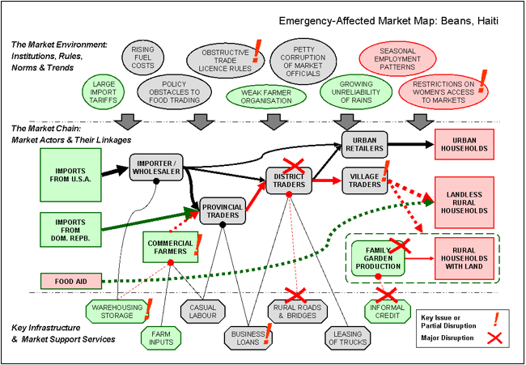
EMMA Tools: Market System Maps

Slide 28
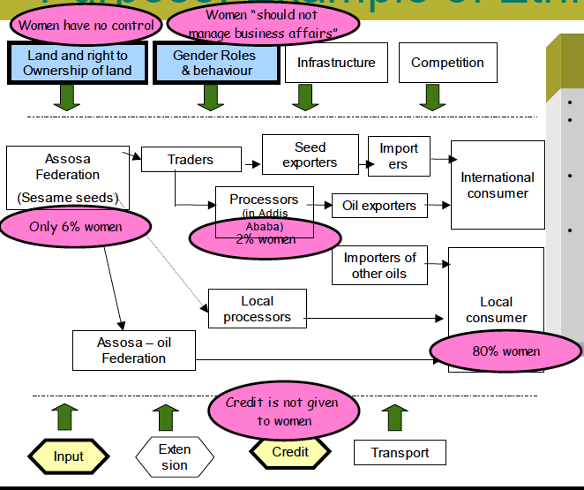
Sex disaggregated market maps

Slide 29
Tools EMMA uses: Seasonal calendars
Notes:
29

Slide 30
Activity: Tools EMMA uses
Read relevant section in the EMMA toolkit:
Household economy profiles (pp.19 – 22)
Seasonal calendars (pp. 22 – 24)
Response options analysis (pp. 28 – 30 + pp. 180 - 181)
Recommendations analysis (pp. 28 – 30 + pp. 181 - 183)
Prepare a three-minute presentation to introduce that section to your peers.

Slide 31
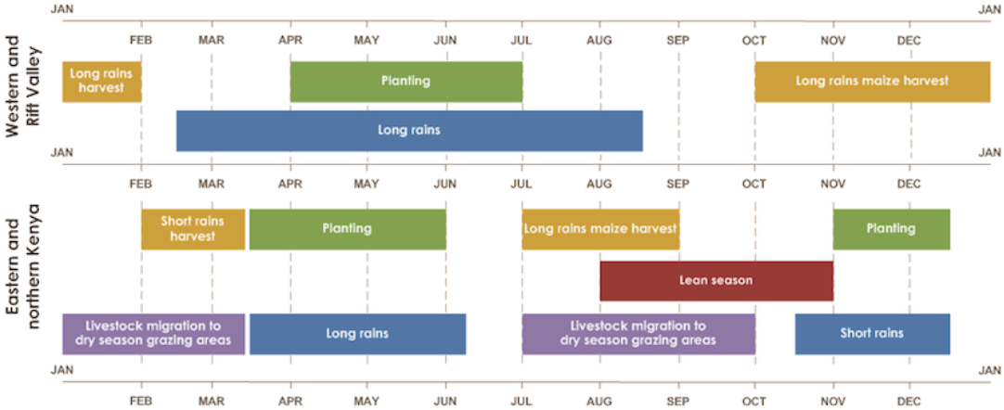
Tools EMMA uses: Seasonal calendar (p 126 or 134)

Slide 32
Tools EMMA uses: Household economy profiles (p 135)

Slide 33
Tools EMMA uses: Response options analysis (p 180)
Response option | Feasibility (low, medium, high) | Advantages | Dis-advantages | Timing

Slide 34
Tools EMMA uses: Recommendations analysis (p 181)
Activities | Risks & assump-tions | Timing issues | Effects on markets and pop. | Indicators

Slide 35
EMMA logic: Three strands
Markets
Gaps
Responses
Programme Options
and
Recommendations

Slide 36
Key points
Market analysis can be simple but iterative, and not necessarily linear
Market system maps are composed of three levels, with visual symbols to communicate changes
Direct and indirect responses both target affected households
EMMA tools include more than market maps
Basic market analysis skills and vocabulary are essential across sectors and agencies

Slide 37
Secondary data analysis
Session 3
Using EMMA to interpret market and household impact

Slide 38
Session guide
Section | Timing | Comments
Activity: Interpreting market system maps | 60
Debrief | 30
Tea | 30
Activity: Interpreting HEA data in relation to market findings | 60
Debrief | 30

Slide 39
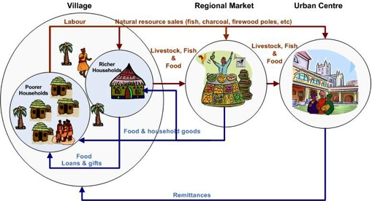
HEA and markets

Slide 40
Session content
Analyse secondary data to identify the market and household impacts of a crisis:
Price, number, volume
Trade, availability, supply, demand, integration
Food sources, income sources, expenditure
Consider direct and indirect interventions.
Identify linkages between market and household analyses.
Interpret changes in the household economy and its possible effects on access.
Recognise the value of secondary data analysis and its contribution to primary data collection.

Slide 41
Types of data

Slide 42
Mini-scenario: Secondary market analysis in Pakistan
You have been seconded to Pakistan for an emergency market assessment, two months after massive floods
Many households have lost half their goats, others are selling at depressed prices
Before beginning your assessment, you are reviewing secondary data:
EMMA report on the goat market system (part 1)
HEA baseline report (part 2)

Slide 43
Market analysis: Key questions
What impacts on market systems have been observed in the emergency situation?
How do current levels of trade and availability compare with the baseline?
Is the market system’s performance limited by supply or demand constraints, or both?
How has market integration been affected?
How have competition and market power been affected?
Can markets respond to gaps?

Slide 44
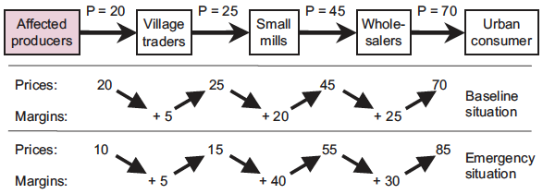
Analysing price margins

Slide 45
Goat market system map: Baseline
Notes:
Price increase for households (approx 25%) post disaster can be significant
NGO volume of livestock = high
Number of retailers has decreased – Could be due to death but more likely loss of business stock/premises/capacity to engage in business.
In the reality there was a loss of credit for the retailers.
Etc....

Slide 46
Goat market system map: Emergency

Slide 47
2

Slide 48

EMMA and the web
Notes:
• The spider is the life, the living creature, the warmth, the centre
• But the web is the life and livelihood of the spider – without it, the spider suffers and dies
• If the web is damaged or destroyed, interrupted in any way, it has to be repaired to
restore the life and livelihood of the spider – and its family
• If it needs support, we could just provide the spider with immediate needs and look after it
• But better to help it repair and restore the web and look beyond the spider to the web
beyond
• The web is the market system with all it intricacies and complexities
• EMMA is not about markets, it is about people, but it looks beyond the immediate to the
markets that feed, clothe, provide shelter and support and enable the livelihoods of
communities and households affected by emergencies.
EMMA SUPPORTS THE SPIDER BY SEEING THE WEB.

Slide 49
Day 2 plan
Session | Timing
Review of Day 1 | 30
Price analysis | 90
Tea | 30
Mahimani 1: Critical market selection | 90
Lunch | 60
Mahimani 2: Initial mapping | 90
Tea | 30
Mahimani 3: Final mapping | 90

Slide 50
Price analysis
Session 5

Slide 51
Session guide
Section | Timing | Comments
Price analysis group work | 30 | 6 groups with 1 task each, with presentations and plenary analysis
Price analysis presentations | 30
Price and volume activity | 30 | If time and facilitator interest permit

Slide 52
Session content
Understand the purpose and process of price analysis.
Apply key concepts to analyse markets or household access:
Integration
Terms of trade
Data interpretation

Slide 53
Analysing price margins

Slide 54
Activity: Price analysis
Form groups and focus on the graph you receive from facilitators.
Analyse the graph in response to the question and prepare a detailed set of conclusions.
Be prepared to present and justify these conclusions in plenary, while walking the other groups through your analytical process.

Slide 55
Which graph do you prefer? Why?

Slide 56
Summarise the trend in terms of trade and how it might affect household food security and coping.
April | Goat | Maize (100 kg) | Terms of Trade
2006 | 220 | 153 | 1.44
2007 | 225 | 147 | 1.53
2008 | 357 | 332 | 1.08
2009 | 350 | 375 | 0.93
2010 | 350 | 315 | 1.11
2011 | 453 | 500 | 0.91

Slide 57
Would you rather be a shoat household or a cow household?

Slide 58
Are these maize markets integrated? Justify your answer with the data.
Notes:
Maize markets in southern Ethiopia 2006-2011.
Source: WFP

Slide 59
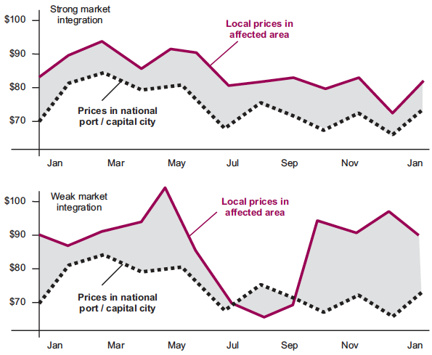
Explain the differences between these two graphs and what they show us about market integration
Notes:
Strongly integrated markets:
Prices tend to follow similar seasonal patterns, rising and falling in unison
The price difference between markets stays relatively constant (grey shading in graph 1)
Weakly integrated markets:
Prices tend to follow dissimilar patterns
Big seasonal variations occur in the price difference between markets (grey shading in graph 2)
Source: EMMA Toolkit, pg 142.

Slide 60
Summarise differences between poor and better off livelihoods, and the impact on household resilience.
Notes:
Data and chart from British Red Cross/Bangladesh Red Crescent Society 2013, used with permission.
Annual income for poor households is less than annual expenditure in all locations. The gap is greater in the fishing zone than the agriculture zone. Most poor households are therefore indebted to microfinance institutions, moneylenders, and relatives to fill their income gap. This conclusion is supported by the high proportion of expenditure on debt payments in the expenditure analysis.
Income and expenditure are approximately equal for middle households, with little opportunity for savings or investment in diversification.
For better off households the situation is different. Their expenditure is significantly higher than middle and poor households. Better off are the main producers in livestock, agriculture, and fishing (as seen in their food and income analyses), and able to invest in these livelihood activities and related inputs. They are also taking credit, but these tend to be larger business loans from banks than smaller loans from microfinance institutions or local moneylenders. Savings are also more feasible for better off households, in addition to investment in other productive assets and household construction quality for example.

Slide 61
Prices and household access

Slide 62
Supply and demand
Supply: Market capacity to deliver goods or services
Demand: Household ability to access goods or services
Physical access
Financial access
Notes:
o It is vital to understand whether the changes in production and trade observed
are essentially symptoms of demand problems, or supply problems, or
combination of both.
o Demand = people’s ability to pay for goods and services they need.
o Supply = other people’s capacity to deliver those goods or services.
Supply problems and demand problems page 147
How to do it qualitatively? Page 147
How to do it quantitatively? Page 149

Slide 63
Market performance
How would you measure the market performance?
What information would you collect?
Interaction supply and demand
Integration
Market power
Infrastructure & services
Prices
Volumes
Stocks
Lead times
Number of actors
Credit / access to funds
Transport
storage
Notes:
What information would you collect to describe the performance of markets:
Market characteristics
Data to collect

Slide 64
Market power
The ability of an enterprise, trader, or other market actor to alter the price of a good or service without losing all their customers, suppliers, or employees to competitors.
In an ideal, perfectly competitive market, market actors would have no market power.
However: barriers to entry, entrenched gender and social relations, collusion, and other anti-competitive forms of conduct often enable some market actors to dominate price negotiations.
(Also refer to monopoly, competition, cartel.)
Notes:
Market power definition page 143
Changes in competition and market power p 151
o Competition = rivalry in the market place; where buyers/sellers have real choice
between alternative market actors.
o Opposite is market power, especially monopoly. Arises when a single market
actor – or small cartel in collusion – able to dictate/strongly influence prices, so
excess profits or control over resources, services or knowledge.
o Refer Toolkit page 8-6, points on ‘positive’ and ‘negative’ aspects of conduct.

Slide 65
Market integration
The measure of how well connected market-systems in different geographic areas are.
A market system is integrated when linkages between local, regional, and national market actors are working well.
In an integrated market system, imbalance of supply and demand in one area is compensated by the relatively easy movement of goods from other markets.
Notes:
Page 141 to 143: Market integration definition / how to assess market integration
Reduced market integration: p 150 -151
o Market integration = the measure of how well connected market-systems in
different geographical areas are to each other, the flow of items and food stuffs
and how this affects movement and prices.
o A good example of market integration is the market for sea fish in East Africa.
Before the advent of mobile phones, fishermen offloaded their catch at their
local port. This meant that there were sometimes shortages or surpluses of
certain types of fish in one port, while the situation was reversed at another
port. For example, there may have been an abundance of sailfish landed at Dar
es Salaam while there was a shortage in Bagamoyo. Fishermen offloading
sailfish at Dar es Salaam would therefore get a depressed price. Now
fishermen have mobile phones with them in their boats, they are able to offload
their catch at the port where the prices are best. This removes the localised
peaks and troughs in demand caused by surplus or shortages. The market
system for sea fish in East African ports is now an example of a well-integrated
market.
o Refer to Toolkit, page 8-4: Market Integration, and the four points describing
why market integration is a vital consideration for EMMA’s analysis of
appropriate responses. Possibly refer also to Box 8.5 for example.

Slide 66
Why is price monitoring relevant?
As an indicator of market readiness for cash/or in-kind
To set cash transfer amounts (grant values)
To monitor impacts of blanket distributions of large in kind and large scale CTPs, by multiple agencies.
Small value grants, to a few targeted, scattered beneficiaries, by just one agency are unlikely to have market impacts. Unless the market was not ready!
Seasonal analysis of price is vitally important
Analyse if the market itself needs help to recover and respond? Indirect market interventions

Slide 67
Activity: Price and volume
Read the handout.
Be prepared to describe the relationship of price and volume, and how changes in one affect the other.
Describe what these changes could mean for households in an emergency context.
Give examples of how an emergency can affect price and volume. Are these different in slow/sudden onsets, or longer term risk reduction programming?

Slide 68
Key points
Lives and livelihoods are supported by a complex web of people, structures, services, and rules.
Price analysis informs our analysis of household access to critical market systems.
Price analysis is part of determining the feasibility of cash transfer programming.
Basic market analysis skills and vocabulary are essential across sectors and agencies.

Slide 69
Critical market selection
Session 6

Slide 70
Session guide
Section | Timing | Comments
Critical market systems and key analytical questions | 15
Scenario 1 | 60
Debrief | 15

Slide 71
Session outcomes
Define critical market systems and their role in assessment and analysis.
Select critical market systems in relation to systematic criteria.
Specify key analytical question(s) to guide the market analysis process.
Begin thinking about data collection needs.

Slide 72
What is a critical market system?
In an emergency, critical market systems are those that had, have, or could have a major role in ensuring the survival and/or protecting livelihoods of the target population.

Slide 73
Notes:
Survival:
Supply = Market systems that provide food, essential household items, or services to meet urgent survival needs.
Livelihoods:
Supply = Market systems that provide essential tools, replace assets, provide agricultural inputs, or deliver vital services.
Income = Market systems that provide jobs, create demand for wage labour, or provide buyers for target groups own production.

Slide 74
Selecting critical markets:
Critical market selection by market analysis trained staff;
Preferably the team in close coordination with local knowledge experts
Realistic number of critical markets!
What are the NGOs likely to want to buy in bulk? Timber?
Narrow down as far as possible (e.g. from livestock, to live sheep, or goat meat or buffalo milk?
Markets related to income and expenditure of most likely target groups (vulnerable)
Are outside traders likely to step in? Alternative or substitute goods available?

Slide 75
Critical market selection criteria
Most significant or urgently relevant market systems
Most affected market systems
Seasonality and timing
Emergency response feasibility
Agency / donor mandate and competencies
Plans of government and other agencies
Others?
Notes:
EMMA pp 50-53

Slide 76
Selecting critical markets vs. identifying needs
There is a difference between identifying ‘needs’ and selecting ‘market systems’, especially in economic activities.
Consider the following, for example:
A poor coastal community who live by fishing for the local tourist hotel
market: if their main emergency problem is a loss of boats and nets, then the market analysis needs to concentrate on understanding the market system for fishing inputs.
However, if they lack buyers for their catch, then market analysis needs to examine the whole market system for fish from fisher-folk through to consumers in hotels or the city.
Landless households who mainly depend on seasonal agricultural work: if their main employers are local large-scale export-orientated wheat farmers, then the critical market analysis priority may be the national market system for wheat.
Notes:
a critical market depends on perspective of group – we need to focus on target group.
It is vital to be specific about the needs of a group, for example, if think about not just ‘maize, but what type (different qualities, maize flour...etc. This is because different products will have different market systems).
How to be specific about needs? EMMA suggests:
Look at recent rapid or emergency needs assessments, and security updates.
Review previous studies of people’s livelihoods and the local economy (ref. Step 1), i.e. what is known about the sources of food and income for different target groups.
Consult as broadly as possible with local colleagues who have already visited the disaster area, or who know the population well.

Slide 77
Key analytical questions
Priority focus of the study
Specific programmatic questions to which the assessment is expected to answer in order to contribute to programme design
=> Guiding questions
Notes:
Def p 46 Box 2.10
Key analytical questions
‘Market systems are usually selected because agency staff have specific ideas or expectations about the operational value that EMMA will add. ‘Key analytical questions’ frame these ideas, and thus help teams to keep them in mind throughout the EMMA process’.
(EMMA toolkit pg 46)
Provided that the selection process was done carefully, it should be possible to identify specific and tangible reasons for analysing the market in each selected market system. These reasons can usually be expressed as ‘key analytical questions’ which EMMA aims to answer
These key questions are vitally important, because they provide the following:
an easily accessible explanation of the objectives for market analysis for managers;
a means of explaining the market analysis to colleagues, key informants, and interviewees;
a focus for the market assessment team’s efforts during fieldwork.
However, don’t forget that this is an iterative process. The key questions are not set in stone at this stage: they will most likely change or be added to later in the process.
(adapted from EMMA toolkit pg 54)
Key analytical questions are those that will help answer the questions we have about what responses we should do. They might include questions such as: can the market meet the needs of the target group? Can we use the market to respond? Does the market system need to be strengthened to address needs? These questions form the basis of the market analysis (answering the key analytical questions), which in turns forms the basis of the responses (addressing the needs of the target group).

Slide 78
Key analytical questions
Haiti – CGI
Does the CGI market system have the capacity to respond to the need for CGI sheeting in post-earthquake Port au Prince?
What preference do affected families have for receiving shelter assistance?
Liberia - Imported rice market system
Has there been any change in consumer demand as a result of the refugee influx?
What capacity does the imported rice market system have to supply the vulnerable host communities and refugees?
What are the main constraints affecting host communities and refugees access to imported rice?
Notes:
Share some examples of key analytical questions, such as in box 2.10 on (pg 55), or others, from personal experience or that seem relevant/interesting.
Give a brief explanation of the context. For example: In Haiti, the market assessment team considered that CGI was a critical market, because.....the key analytical questions were as follows:

Slide 79
Key points
Selecting critical marketplaces and markets is essential.
We need to distinguish between critical markets for survival and for livelihoods.
We also need to distinguish between critical markets for supply and for income.
Critical markets must be tightly defined.
Every crop, item, service, etc has a unique market system for separate analysis.

Slide 80
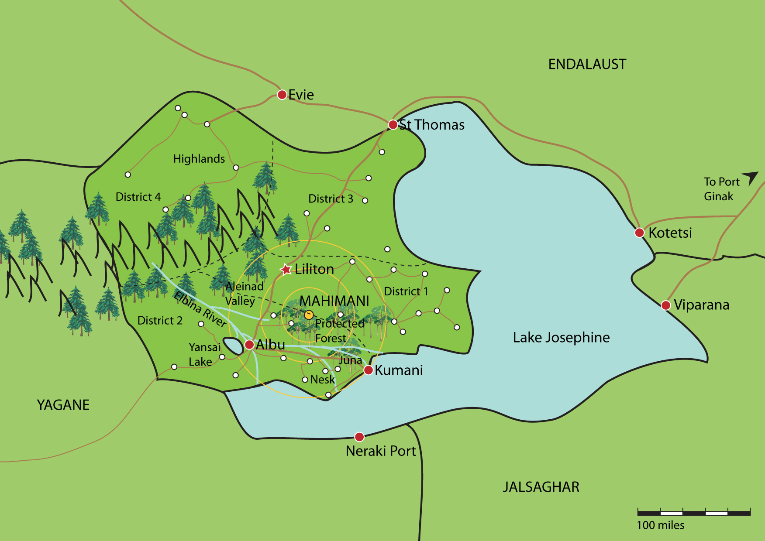
Mahimani
Notes:
80

Slide 81

Lake Josephine
Notes:
81

Slide 82

Earthquake
Notes:
82

Slide 83
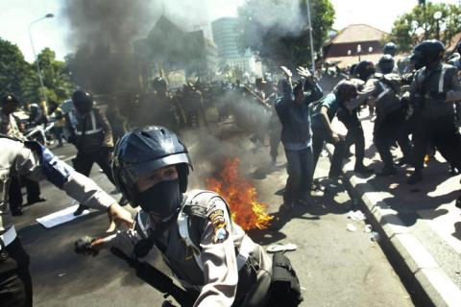
Rioting and conflict
Notes:
83

Slide 84
Scenario 1: Critical markets
Refer to the task sheet ‘Critical Market Selection’:
Which critical markets could be considered in response to this crisis? List them.
Using the criteria for critical market selection, which one critical market will your agency respond to? (Add your own criteria too!)
What is the key analytical question for the critical market system you selected?
Who could be interviewed to learn more about your selected critical market system?

Slide 85
Initial market mapping
Session 7

Slide 86
Session guide
Section | Timing | Comments
Scenario 2: Initial mapping | 80
Debrief | 10

Slide 87
Session outcomes
Apply the iterative process of developing market system maps from primary and secondary sources.
Illustrate changes to market systems.
Interpret initial changes against a baseline.
Understand the importance of a relevant baseline.

Slide 88
When is your baseline? What is a ‘normal’ time?
Should be same time for each critical market, but this has problems.
When is normal?
Protracted conflict
Political repression
Chronic seasonal shocks
Urban centre
Etc…
Realistically it has to be in specific recent memory.

Slide 89
Scenario 2: Initial mapping
Refer to the task sheet ‘Initial Mapping’:
Prepare initial baseline and emergency market system maps for the critical market your group has been assigned.
You have extensive documentation to help.

Slide 90
Key points
Need to expand our perspective of respondents and key informants, not just the ‘usual suspects’.
EMMA users must be guided by their key analytical question(s).
Practicalities of ‘before’ date selection for baseline.
Keep it simple: maps usually start basic but expand iteratively.

Slide 91
Final market mapping
Session 8

Slide 92
Session guide
Section | Timing | Comments
Scenario 3: Final mapping | 75
Debrief | 15

Slide 93
Session outcomes
Complete baseline and emergency maps.
Indicate changes in P, N, V and interpret their implications on the market system and household access.

Slide 94
Scenario 3: Final mapping
Refer to the task sheet ‘Final maps’:
Review the additional information you have collected in the field.
Update your baseline map.
Update your emergency map.
Try to include PRICE, NUMBER, VOLUME

Slide 95
Firewood in Mahimani: baseline
Market Environment:
Institutions, Rules, Norms, Trends
Bribes / corruption
Growing use of LPG
Permits for harvesting
Forestry dept. Ecological Policies
Seasonal demand variations
The Market Chain:
Market Actors &their Linkages
Private wood producers
Large KUMANI retailers
Exports
$2.9 / BB
$1.5 / BB
$2.5 / BB
$2.9 / BB
$3 / BB
Local Industry
Contractors
Small retailers
$1 / BB
$2.8 / BB
Illegal harvesting
$4 / BB
Urban Households
Scavenging
Key Infrastructure & Market Support Services
Transport from D1 & D4 to KUMANI market
Daily
Labour
Transport from KUMANI to all Districts
Transport from KUMANI to St. Thomas
Warehousing

Slide 96
Firewood in Mahimani: emergency
Market Environment:
Institutions, Rules, Norms, Trends
Bribes / corruption
Child protection issues with scavenging
Use of LPG
Permits for harvesting
Forestry dept. Ecological Policies
Seasonal demand variations
Private wood producers
Large KUMANI retailers
n = 2
Exports
The Market Chain:
Market Actors &their Linkages
$2.5 / BB
$5 / BB
Local Industry
$6 / BB
Contractors
n = 10
Small retailers
n = 3 / village
$3 / BB
Households
Illegal harvesting
$6 / BB
$8 / BB
$8 / BB
IDPs Households
Consumption
Scavenging
Key Infrastructure & Market Support Services
Transport from D1 & D4 to KUMANI market
Transport from KUMANI to all Districts
Transport from KUMANI to Port City
Tendering &
bid procedures
Daily
Labour
Warehousing

Slide 97
Beans in Mahimani: baseline
Market Environment:
Institutions, Rules, Norms, Trends
Foreign Exchange
Government Taxes
Bribes
Gender Roles
Regional
Market
(consumption)
Consumption
Local Market
Private
Wholesaler/
Exporter
V=10000
Regional
Market
(local consumption
& humanitarian)
5000 MT
$150/MT
Independent
Agent
5000 MT
Port Capacity 300 MT/day
Farmers
N=3600
$200-250
50 MT
N=500
$500/10MT
$250-300
Wholesaler
Agent
Government
Exporter
V=8000
International
Market
(processed food
industry)
N=1500
The Market Chain:
Market Actors & their Linkages
$200
N=2000
$500/10MT
Government
Agent
Capacity for
10000MT beans
Key Infrastructure & Market Support Services
Warehousing
Transport
Credit
Quality Testing

Slide 98
Beans in Mahimani: emergency
Market Environment:
Institutions, Rules, Norms, Trends
Government Taxes
Gender Roles
Foreign Exchange
Bribes
Local Market
Regional
Market
(consumption)
Regional
Market
(local consumption
& humanitarian)
Consumption
Private
Wholesaler/
Exporter
?
?
▲ MT
Independent
Agent
▼ MT
Farmers
▼demand
Government
Exporter
International
Market
(processed food
industry)
Wholesaler
Agent
▼/? demand
The Market Chain:
Market Actors &their Linkages
▼demand
Government
Agent
Key Infrastructure & Market Support Services
Quality Testing
Warehousing
Credit
Transport
▲demand

Slide 99
Key points
To ensure effectiveness as communication devices, final market system maps should be:
Visually clear and simple
Seasonally relevant
Consistent with symbols, key, titles, dates…
Information represented on market system maps must be highly selective, achieving ‘optimal ignorance’.

Slide 100
3

Slide 101
Day 3 plan
Session | Timing
Review of Day 2 | 30
Gap analysis | 90
Tea | 30
Response analysis and recommendations | 90
Lunch | 60

Slide 102
Impact and gap analysis
Session 9

Slide 103
Session guide
Section | Timing | Comments
Introduction | 10
Scenario 5: Gap analysis | 50
Debrief | 30

Slide 104
Session content
The role of gap analysis in market assessment
Consolidated analysis at market and household levels
Analysis of whether households can respond to gaps
Analysis of whether markets can respond to gaps

Slide 105
Gap analysis
What are the (quantitative and qualitative) needs of targeted populations / groups with regards to the critical market (key needs)?
How does the target population / group relate (interact / depend) to the market?

Slide 106
HEA and markets

Slide 107
Gap analysis: Target population details
Target group | Female | Male | Location | Essential charater-istics

Slide 108
Gap analysis: Analysis summary
Target group | HH in need | HH shortfall | Other aid and coping | Total gap | Likely gap duration | Prefer-ences for help

Slide 109
Can the markets respond?
Determine the capability of the market system to contribute to the emergency response:
Character of market-system constraints, supply or demand based?
Past performance and current activity.
Availability of stocks.
Degree of market integration at different levels.
Likely conduct of market actors (risks of abuse of market power).

Slide 110
Gap analysis: Quantitative
Estimate of gaps facing target population:
Duration: How long gap might last
Preferences: Target HH considerations
Other assistance: What else is in the pipeline
Sources?

Slide 111
Gap analysis: Qualitative
Constraints on access
Transport needs
Ethnic, gender, other vulnerability issues
Seasonal factors
Coping strategies
Preferences
Risks or challenges

Slide 112
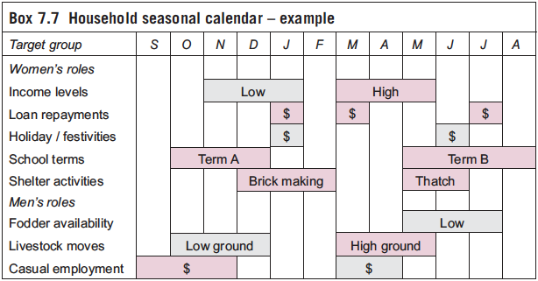
Seasonality and gap analysis

Slide 113
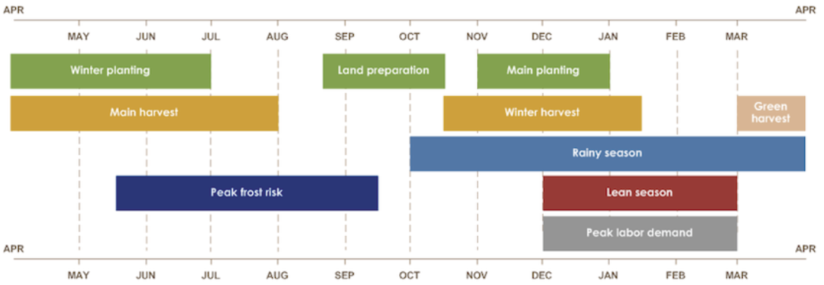
Seasonality: Lesotho
Notes:
Source: FEWSNET

Slide 114
Thresholds – Household needs
Notes:
114

Slide 115
Thresholds
Survival threshold
Livelihoods protection threshold
Includes shelter, nutrition, water, sanitation, health, hygiene, food, livelihoods…
We should look beyond survival programming
Market based responses can reverse or mitigate coping strategies to reach or exceed thresholds
Notes:
Wherever possible, include livelihoods protection into transfer amounts so that households are not always back to survival levels only.

Slide 116
Coping strategies
Reversible | Corrosive
Notes:
The table is simply to illustrate the concept of different coping strategy types. It does not need to be completed.
Discussion can instead compare different examples of each type of coping strategy. Try to highlight how the examples might influence (positively or negatively) household assets and recovery.
Time permitting, it could also be interesting to use the interweaving themes to elicit even more detail from the discussion: slow onset, emergency, urban, conflict

Slide 117
Can the market system cover the HH gap?
MARKET CAPACITY
Market gap
Household needs
Future?
Past
Present (emergency)
Notes:
117
CAN THE MARKET RESPOND? Determine the capability of the market system to contribute to the emergency response
What else do we need to know= people’s need, HH gap
Definition of market gap
WHAT INTERVENTIONS WOULD BE REQUIRED FOR THE MARKET TO COVER THE MARKET GAP?

Slide 118
Activity: Gap analysis
Refer to the task sheet ‘Gap Analysis’:
What is the overall impact on the market system resulting from the emergency?
How does the market system’s level of trade and availability after the emergency compare with the baseline?
Are supply constraints, demand constraints, or both causing changes in the market system’s performance?
Summarise price changes and their impact on affected households.
How has market integration been affected?
Are there changes in the number of actors? Have competition and market power been affected?
Can the market system respond to the gaps outlined in the ‘Summary’?

Slide 119
Key points
Essential questions to answer:
Can markets respond to the gap?
Can households respond to the gap?
We need to determine whether priorities are for survival needs or livelihoods protection.
The duration of the gap is also important, not just its quantity. Seasonality.
EMMA uses household gap analysis data, but does not produce it. How will we get it?

Slide 120
Response analysis and recommendations
Session 10

Slide 121
Session guide
Section | Timing | Comments
Introduction | 10
Scenario 6: Response options | 30
Scenario 7: Recommendations | 30
Debrief | 10’

Slide 122
Agree or Disagree?
Women are able to do the same type of casual labour as men in cash for work projects.
Women will spend cash transfers more appropriately than men.
Women’s expenditure tends to be on general household food and necessities, not on livelihoods and assets.
Informal female petty traders along roadsides are not included in formal market assessments investigating larger trends like integration, supply, demand, etc.
Sex disaggregated data are not practical in a rapid assessment of markets during an emergency.

Slide 123
Session outcomes
Explain the importance of response options analysis.
Identify strengths and weaknesses of response options in relation to objectives and other criteria.
Identify direct and indirect response options.
Suggest cash transfer or in-kind responses.
Consolidate assessment and response options into clearly stated recommendations.
Use EMMA tools for analysing response options and recommendations

Slide 124
Response analysis: rationale
Determine what response logic is most appropriate in each critical market system
Decide what type of direct assistance or other kinds of indirect action, including further investigation, to recommend
Estimate how much assistance is required
Describe when, and for how long, assistance or other indirect support should be provided, and how its impact could be monitored

Slide 125
What is the purpose of response analysis?
To identify responses that are most:
Appropriate and acceptable
Feasible
Cost effective and cost efficient
Can be implemented by agencies, partners, and other actors
Etc…
Notes:
Ask the participants:
what are the implications of this definition for the information they will require to carry out a response analysis?
We need to know, which responses will
• most effectively meet needs
• do least harm
• culturally acceptable
• affordable
• timely
Roles & responsibilities of
• governments
• private sectors / markets
• LNGOs
• UN
• INGOs

Slide 126

Blue sky thinking + reality check
Notes:
Adapted from concept in the IFRC Recovery Guidelines (pg 147).
Response options analysis is about considering a broad range of (informed) possibilities, then applying greater rigour to isolate and prioritise.

Slide 127
Response analysis process
Documenting ALL possible options…
Across all sectors,
Across all phases: immediate, recovery, and DRR.
Applying which criteria to focus possibilities?
Determining timing and targets.
Reviewing appropriate modalities.

Slide 128
Response analysis
Baseline (past): How well did this market system perform before the emergency?
Impact (present): How has this market system been affected by the crisis? What is the market gap?
Forecast (future): How will this market system react to humanitarian action (direct/indirect) or future impacts of the crisis? Can markets respond to gap? Expandability and constraints?

Slide 129
Response analysis
Responses that rely on local market systems performing well | Responses that aim to strengthen or support local market systems
Actions leading to further investigation, analysis, or monitoring | Responses that do not rely on local market systems performing well

Slide 130
Response analysis
Evidence based decisions for:
Direct assistance through cash or in-kind transfers (or both) | Indirect actions to strengthen market systems (and households)

Slide 131
Response options
Response option | Advantages | Dis-vantages | Feasibility (L, M, H) | Timing

Slide 132
Scenario 6: Response options
Complete the response options matrix, adding at least 3 more.
Consider:
Direct and indirect responses
Multi-sectoral responses
Emergency and recovery responses
Disaster risk reduction
You have 30 minutes.

Slide 133
Recommendations analysis
Recommendations must emerge from our analysis.
Can be a combination of direct and indirect responses.
Can be a combination of cash and in-kind.
Can be a combination of CTP modalities.
Should include targeting and timing.

Slide 134
Response recommendations
Activities | Risks & assump-tions | Timing issues | Effects on markets and pop. | Indicators

Slide 135
Scenario 7: Recommendations
Develop three new recommendations, using the matrix.
If recommending cash, try to be specific about transfer value and delivery mechanisms.
Prepare a five minute presentation to decision makers.
You have 30 minutes!

Slide 136
Key points
Response options analysis encourages a more systematic approach to programming.
Recommendations should have clear links with assessment findings and analysis.
Response options can traverse multiple sectors, including risk reduction.
CTP modalities and amounts should anticipate changes in household economy and coping strategies.
Feasibility, timing, and risk are also vital considerations.

Slide 137
EMMA bin

Slide 138
The 10 Steps of EMMA
General sequence of EMMA activities;
Iterative process – steps may be returned to, overlap, as revision continues;
Continues till ‘good enough’ picture is achieved.

Slide 139
The 3 Strands of EMMA
Markets
Gaps
Responses
Program Options
and
Recommendations
Notes:
139

Slide 140
The Essentials of Emma …
…. DETAILED IN PRACTICE, SIMPLE IN ITS ESSENCE
The EMMA Toolkit:
quick, rough and ready analysis with practical recommendations;
suitable for use in early stages of emergencies;
doesn’t rely on specialist economic or market analysis skills
addresses survival needs, livelihood protections and transition to economic recovery
Notes:
140

Slide 141
The Purpose of EMMA
Need for better analysis of critical market systems - enables broader range of responses;
Supports survival and protects livelihoods;
Better use of existing market actors’ capabilities;
More efficient use of humanitarian resources;
Encourages transition to economic recovery;
Less risk of dependency;
Allows pragmatic response to typical human resource and information constraints in sudden-onset emergencies.
Notes:
141

Slide 142
The Purpose of EMMA
EMMA tools are rough and ready, speed-oriented:
early decisions on direct response options;
assessment of complementary indirect options;
“optimal ignorance” & “appropriate imprecision”;
iterative: revise, refine, “good enough” analysis.
Notes:
142

Slide 143
Market Analysis - Impact of the Emergency
5 main questions:
What impacts on the market-system have been observed in the emergency situation?
2. How does the market-system’s current level of trade and availability compare with the baseline?
Is the market-system’s performance essentially limited by supply constraints, demand constraints or both?
4. How has market integration been affected?
5. How have competition and market-power been affected?
Notes:
143

Slide 144
Market Analysis – Can the markets respond?
It is essential to decide about the capability of the market system to contribute to the emergence response. This depends on: …
Character of market-systems constraints – supply or demand based?
Past performance (baseline) and current activity
Availability of stocks
Degree of market integration at different levels
Likely conduct of market actors (risks of abuse of market power)
Notes:
144

Slide 145
EMMA’s Core Logic
Primary reasons for EMMA include consideration of:
early decisions – in-kind versus cash for DIRECT assistant to households;
INDIRECT actions to strengthen market system’s response to gaps.

Slide 146
EMMA’s Core Logic
Possible response options fall into 4 categories. Responses that:
rely on local market systems performing well;
aim to strengthen/support local market systems;
don’t rely on local market systems performing well, but may use regional or national markets;
require prior further investigation, analysis & monitoring.

Slide 147
EMMA’s Core Logic
Core Logic summarised in 3 questions:
Baseline situation [PAST]: “How well did this market system work before the emergency?
Impact [PRESENT]: “How has this market system been affected by the crisis?
Forecast [FUTURE]: “How well is this market system likely to react or respond to proposed humanitarian actions, or future impacts of the crisis?

